Slide 1
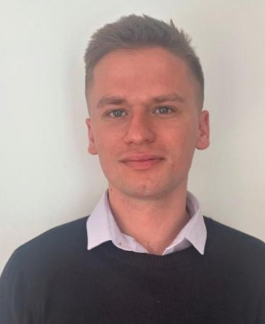
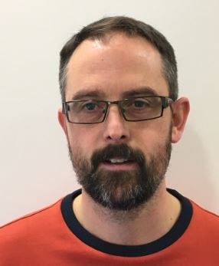
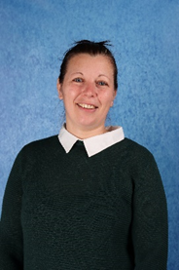
Meet the Year 6 Team
Your teachers are:
Other adults that help us are:
Mr Darke
Mr Wallis (Friday PM)
Ms Ockenden
Mr Smith
Mr Wells

Slide 2
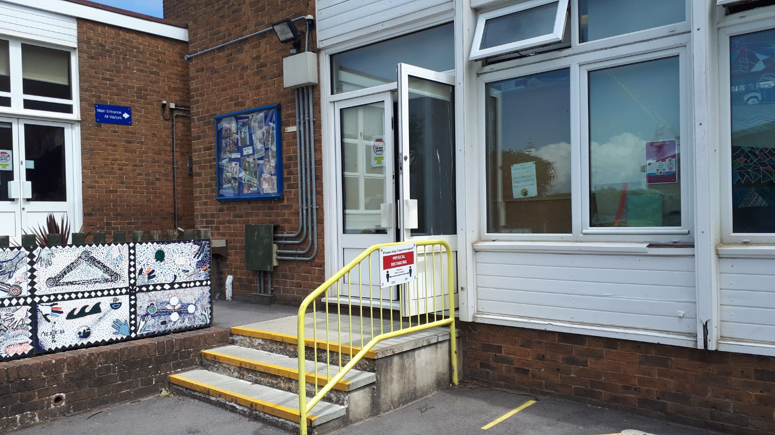
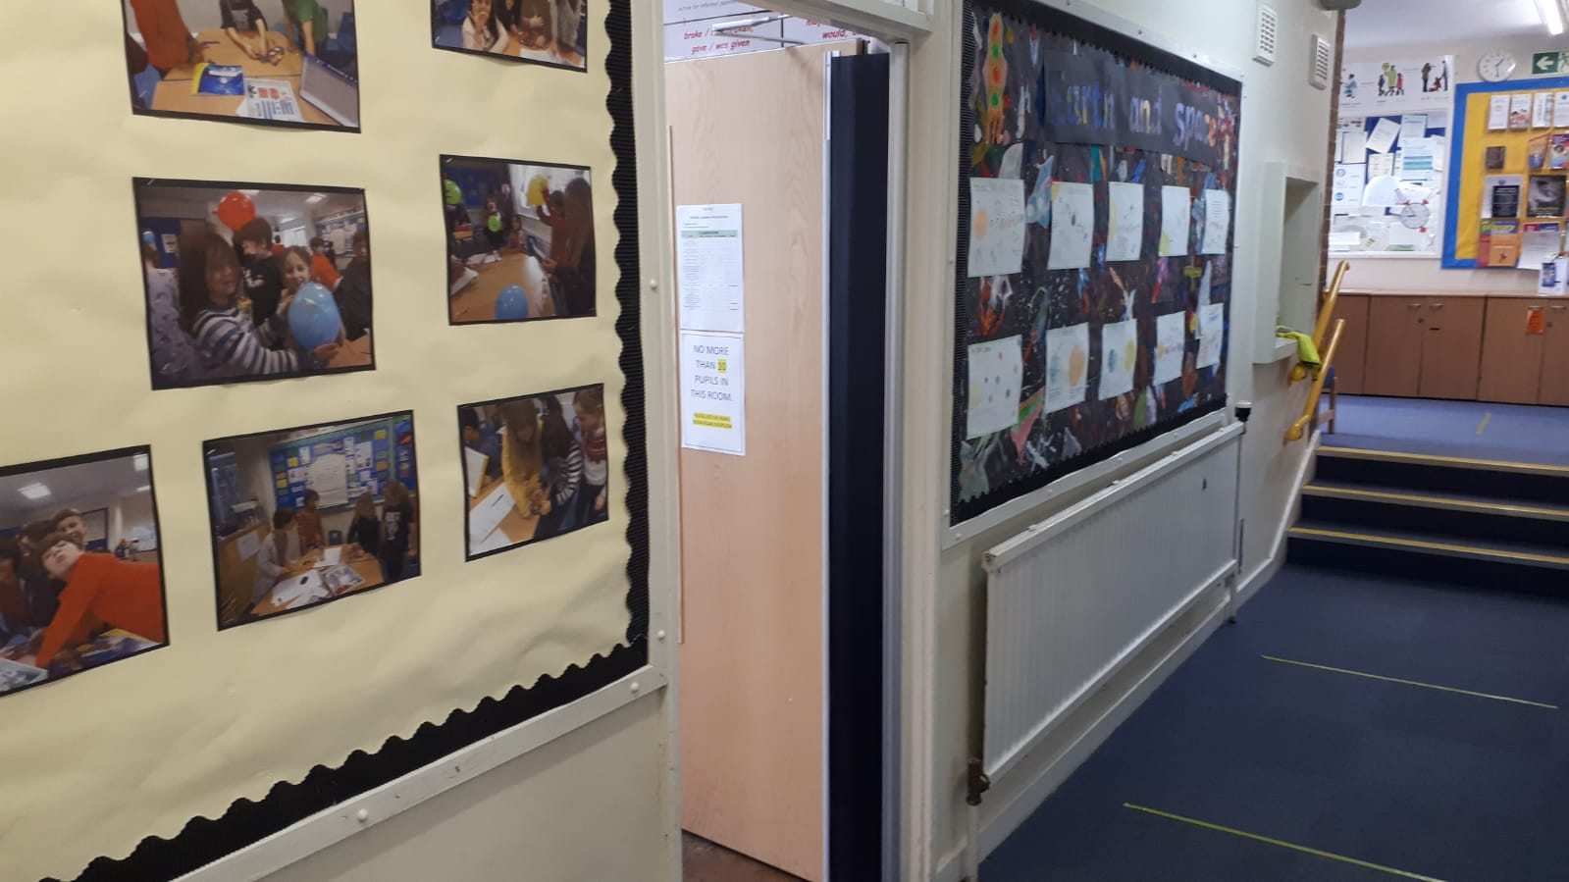
Outside and Inside Year 6

Slide 3
What’s the same as Year 5?
Lunchtimes and playtimes are at the same time
Assemblies are at the same time
We still set homework every fortnight (just in books!)
What’s different to Year 5?
We go on a residential field trip
We have lots of trips –Take Shelter, Parliament, Shoreham Airport, Seven Sisters, Tennis and Volleyball Tournaments, Devil’s Dyke, Hove Fire Station, Sushi-Making, Buddhist Centre and more!
We do SATS tests – but they’re nothing to worry about!
We get ready for secondary school
We do a leavers’ play, a legacy project and have hotdogs on the school field
On PE days, we wear our PE kits to school (Tuesday and Wednesday)

Slide 4
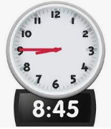






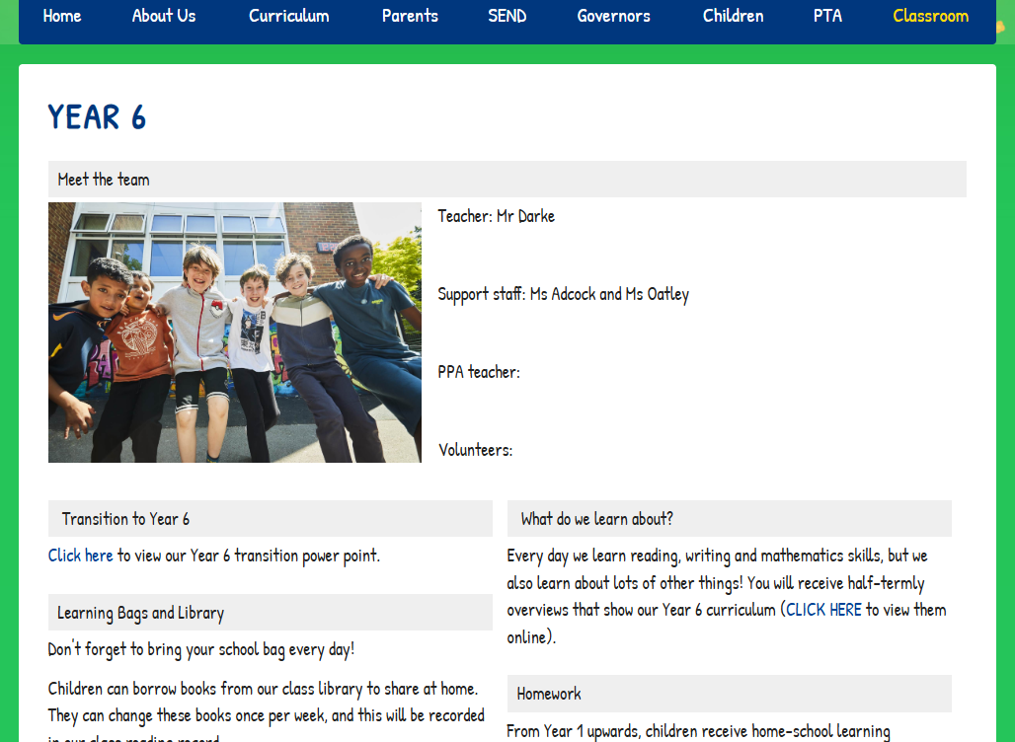


Timetable and Webpage
School day starts
Playtime (15mins)
KS2 Lunchtime (1 hour)
Home time
Each term we will give you a more detailed timetable, showing an overview of a typical week, to keep at home.
We will also share the weekly timetable on our class webpage.
The class webpage has lots of useful information. You can find it here:

Slide 5


What do we learn about in English and Maths?
Every day we learn about reading, writing and mathematics.
Here is a very light overview, and you will also receive more detailed half-termly overviews.
Here are a few of our English projects…
Writing about waste monsters inspired by ‘Planet SOS’ by Marie G. Rhode
We write biographies about young people who have
changed the world.
We learn lots of new concepts in maths. Here is a ‘place value’ example:
Think about the number 34 567 800.
Say this number aloud.
Round this number to the nearest million.
What does the digit ‘7’ represent?
Divide this number by 100 and say your answer aloud.
Divide this number by 1000 and say your answer aloud.

Slide 6
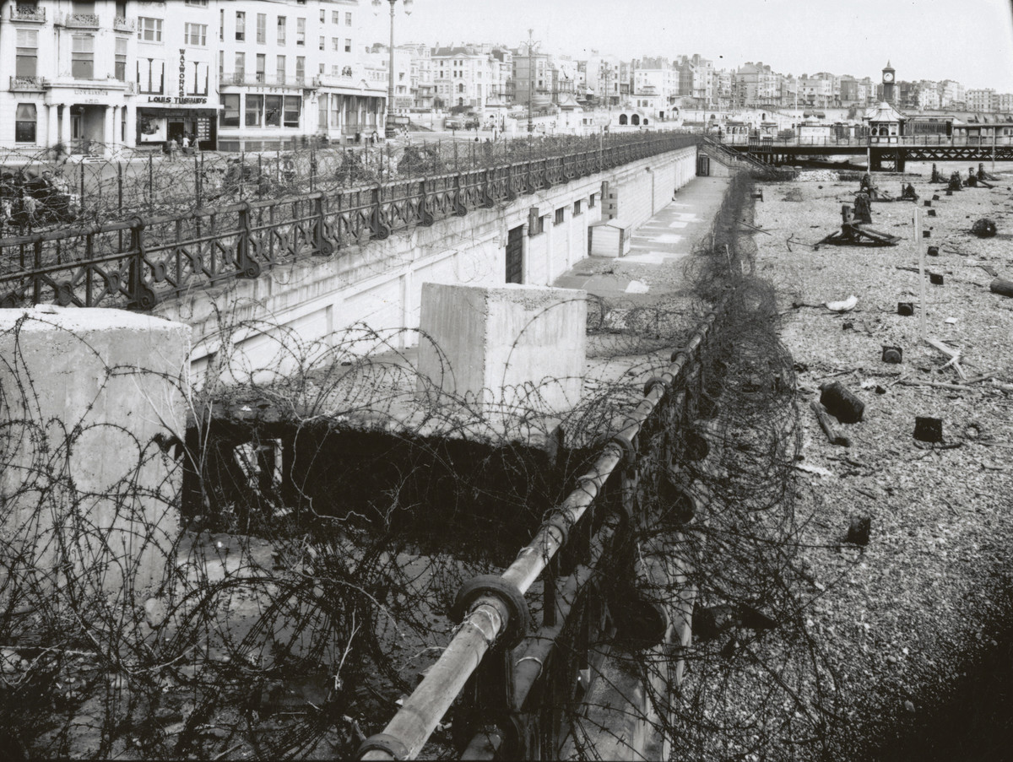
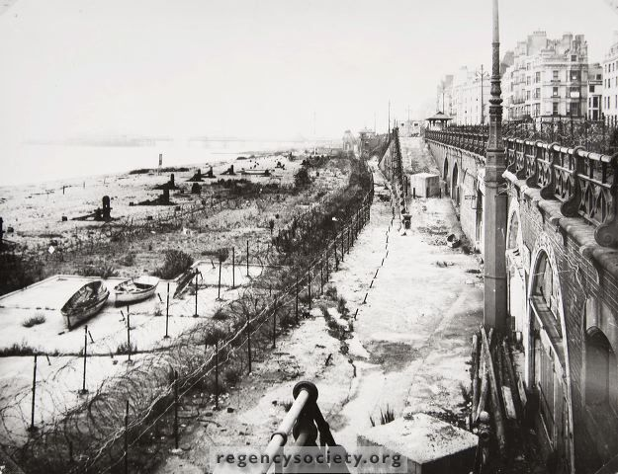
What do we learn about in Autumn?
Here is a very light overview, and you will also receive more detailed half-termly overviews.
GEOGRAPHY: Locational knowledge and Map Skills
(3 weeks)
We expand map skills to include non-UK countries.
Can you name and locate on the world map any countries in Africa or Asia?
Can you use maps, atlases, globes and digital/computer mapping (Google Earth) to locate countries and describe features studied?
SCIENCE: Electricity (3 weeks)
Revisit simple circuits (cell, a bulb in a holder and wires connected by crocodile clips).
Why doesn’t the bulb light if the If the cell is missing?
Lots of hands on work with circuits!
Autumn term 1 History
Join Year 6 as we start our History focus on World War Two.
We will be looking at this very important event on a local, national and international scale.
What did World War Two mean to those living in Sussex?

Slide 7
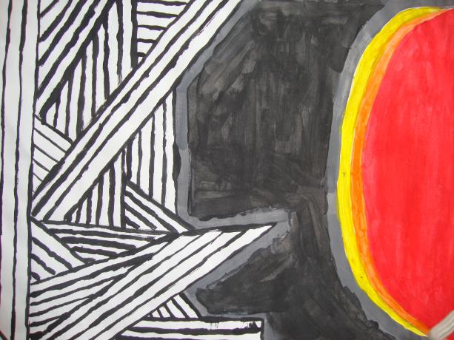
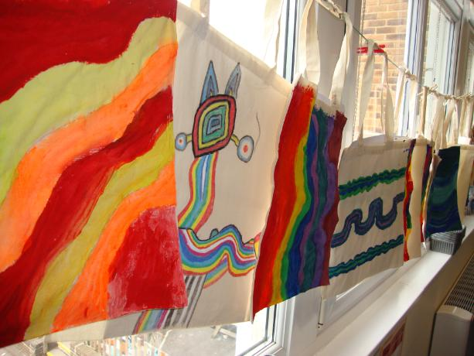
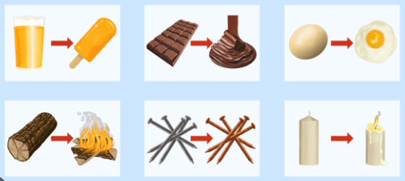
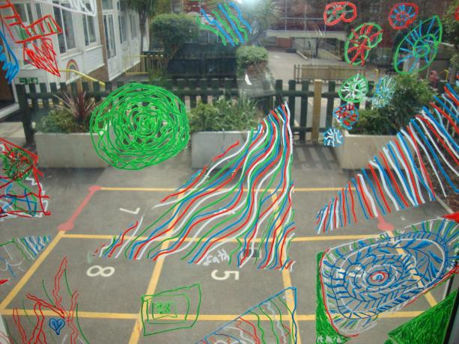
What do we learn about in Spring?
Here is a very light overview, and you will also receive more detailed half-termly overviews.
Spring term 1 Science
Could you be the next CSI investigator?
Changes in materials - filtering, dissolving, reversible and irreversible changes.
Evaporation and condensation.
(6 weeks)
Spring term 2 Art
WHOLE SCHOOL ART FOCUS !
We plan this with a local artist and the theme changes every year.
Here are a few past projects…

Slide 8
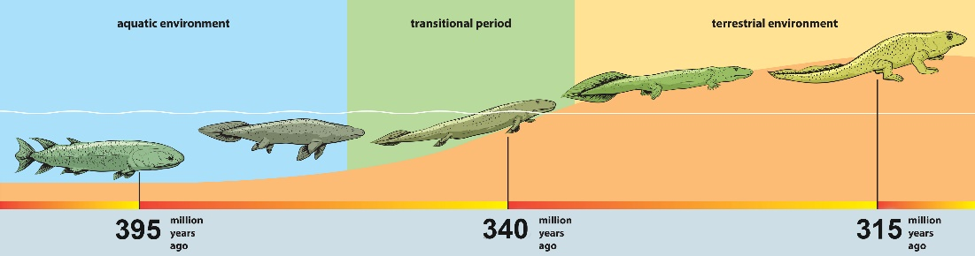

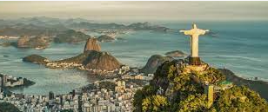
What do we learn about in Summer?
Hee is a very light overview, and you will also receive more detailed half-termly overviews.
Summer term 1 Geography
Exploring Beautiful Brazil
What are volcanoes and Earthquakes?
What are human and physical features?
Who are the Awa tribe?
Summer term 2 History
What was the Golden Age of Islam?
Learning about the importance of Baghdad as a developing city of knowledge, culture and learning.
Summer term 2 Science
Classification, Evolution and Inheritance
Why are fossils so important to the theory of evolution?

Slide 9
Trips

Slide 10

Secondary School Admissions
Apply by 31st of October
You will receive information about open days
Please talk to the office if you need any help with this

Slide 11
SATs
We take our SATS tests (Statutory End of Key Stage Assessments) in May - please don’t book any holidays for that month!
Tests take place for English Reading, English Spelling and Grammar and Maths
English Writing is ‘teacher assessed’ so there is no writing test
We will send out a letter nearer the time with more information
Lots of our Y6s say they love SATS week as we give lots of extra support and loads of extra playtimes!

Slide 12
Year 6 Residential Trip
Windmill Hill PGL

Slide 13
Arrangements for Monday
Please bring your child to school at the regular time
If it is dry, children can leave their bags by the benches on the Year 6 patio
The coach will pick us up at around 10am, but please say your goodbyes at regular drop-off time.
Children will need a packed lunch and plenty of water.

Slide 14
Arrangements for Wednesday
We aim to be back for the end of the regular school day.
In the event of any unexpected delays, the school will keep you updated via school ping.

Slide 15
Medical forms:
Please make sure you have returned your child’s medical form to the school office.
Planned activities:
Raft building
Archery
Zip Wire
Giant Swing
Survivor
Orienteering
Problem Solving
Climbing
Den Building
Disco!

Slide 16
Kit list
To ensure that children enjoy the trip to Windmill Hill, it is important that you send them prepared for the adventurous activities and the British weather.
There is always the chance that it could get cold, and the majority of our sessions take place outside, so pack layers like long sleeved tops and fleeces combined with warm socks, hats and gloves.

Slide 17
T-shirts and a long sleeved top for archery
Sweatshirts/fleeces
Trousers (tracksuit bottoms NOT JEANS)
Waterproofs (jacket and trousers)
Clothing to wear in the Centre
Gloves and hat
Plenty of spare underwear and socks
Old trainers
Wellington boots
Shoes to wear indoors and/or slippers
Towel
Toiletries
A book to read before bedtime

Slide 18
Hints and Tips
• No mobile phones or electronic devices please. • Children will not need any spending money.
• Bedding and pillows for sleeping are not provided.
• A large bin liner is ideal for carrying wet dirty kit
• Do not over pack their bag – they have to be able to carry it!

Slide 19

Homework
Homework is an important part of many schools and becomes more important at secondary school.
It is STILL important to read with your child every day (they aren’t too old!) and give them time to read independently (and listen to audiobooks!)
Please encourage your children to complete the tasks.
As the year goes on, we also ask children to complete certain revision tasks to help them prepare for their assessments.

Slide 20
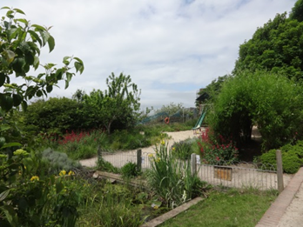
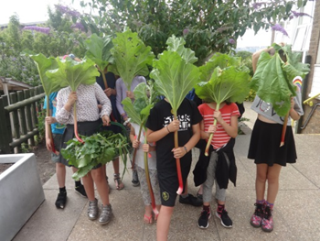
Top 6 Things about Year 6
1. The children (very friendly)
2. Lots of learning (we can do it!)
3. Extra playtimes (amazing playground)
4. Golden Time and Marble Rewards (fun times)
5. The legacy project and treat on the field
6. We have our own class set of Chromebooks
And remember CARLTON HILL IS AWESOME!

