Slide 1
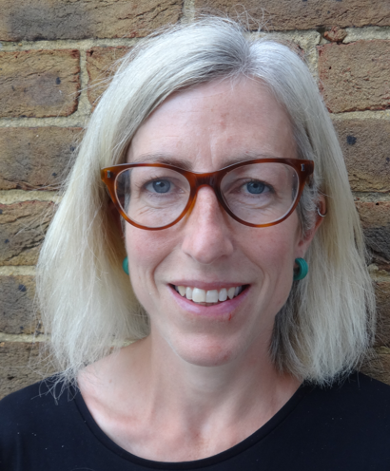
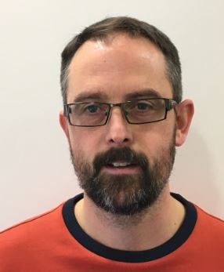
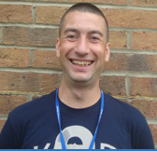
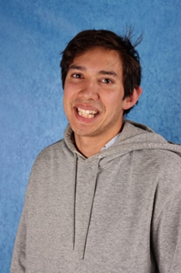
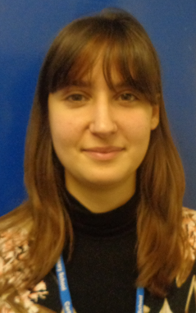
Meet the Year 5 team
Your teachers are:
Other adults that help us are:
Mr Leahy (Thur, Fri)
Mr Wallis (PPA)
Ms Jo Peckham (Mon – weds)
Mr. Pakpahan
Ms. Bowles

Slide 2
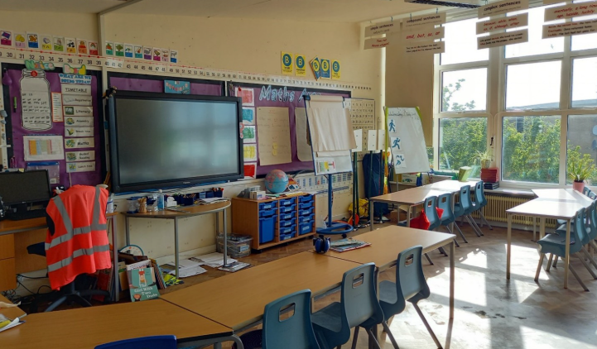
Year 5

Slide 3
What’s the same as Year 4?
Lunchtimes and playtimes are at the same time
Our classroom is upstairs
We still set homework every fortnight
What’s different to Year 4?
More independence and responsibility as we enter the upper half of Key Stage 2
We usually go on a trip to London to the Science Museum
We usually visit the Royal Pavilion and Brighton Museum

Slide 4





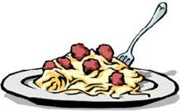


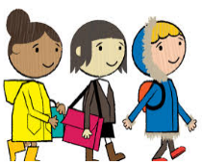
Timetable and Webpage
School day starts
Playtime (15mins)
KS2 Lunchtime (1 hour)
Home time
Each half term we will give you a more detailed timetable, showing an overview of a typical week, to keep at home.
We will also share the weekly timetable on our class webpage.
The class webpage has lots of useful information. You can find it here:
https://www.carltonhill.brighton-hove.sch.uk/Year-5/

Slide 5
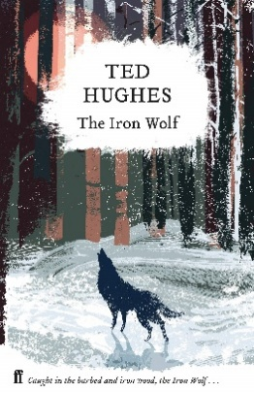
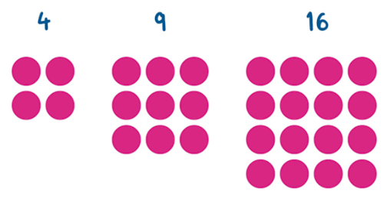
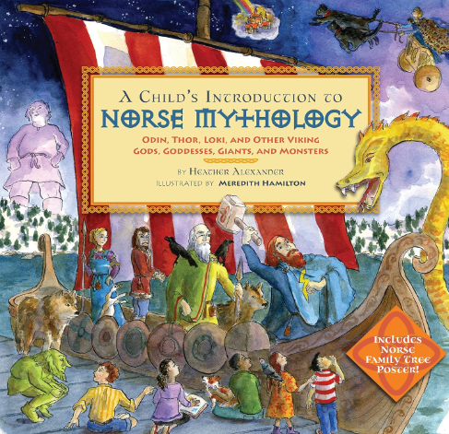
What do we learn about in English and Maths?
Every day we learn about reading, writing and mathematics.
Here is a very light overview. You will also receive detailed half-termly overviews.
Our first two English projects…
Poetry inspired by ‘Amulet’ by Ted Hughes.
An information page about Norse Mythology. Our key text is by Heather Alexander.
We learn lots of new concepts in maths including:
What digit is in the tens place in 133,407?
Can you round 14,502 to the nearest 1,000?
Can you recall all prime numbers up to 19?
Do you know any square numbers (x²) or cube numbers (x³)?

Slide 6
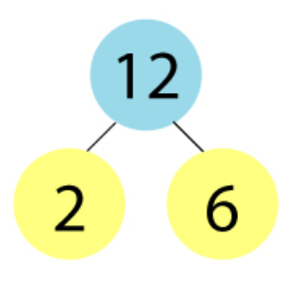
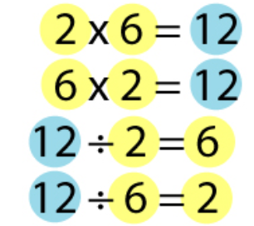
Please support at home with maths fluency!
In Year 4, we worked hard at learning all of our tables facts.
This year, we are learning the division facts that go with our tables facts.

Slide 7
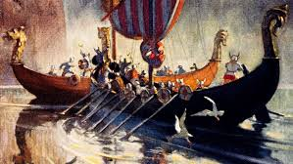
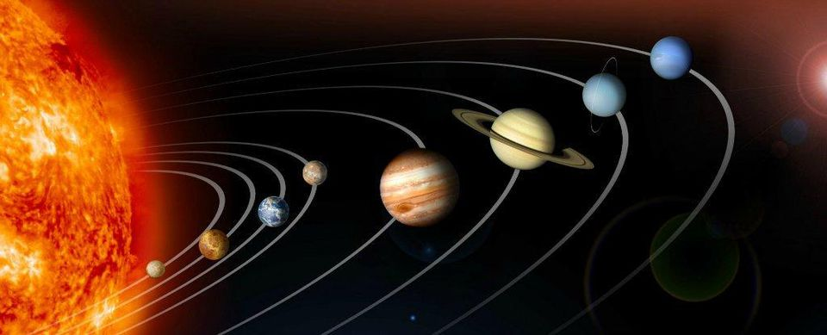
What do we learn about in Autumn?
Here is a very light overview, and you will also receive more detailed half-termly overviews.
Autumn term 1 History
Following on from Y4, when we learned about the Romans, we learn about the Anglo-Saxons and the Vikings.
GEOGRAPHY: Locational Knowledge and Map Skills (3 weeks)
SCIENCE: Would you like to live on the moon?
Space & Gravity (3 weeks)

Slide 8
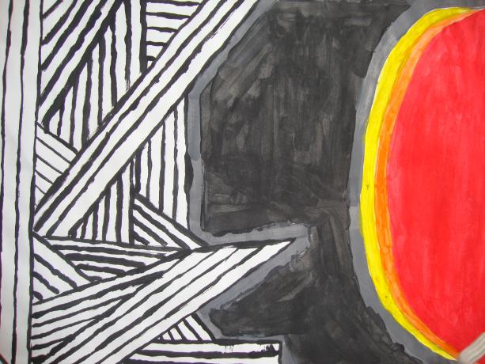
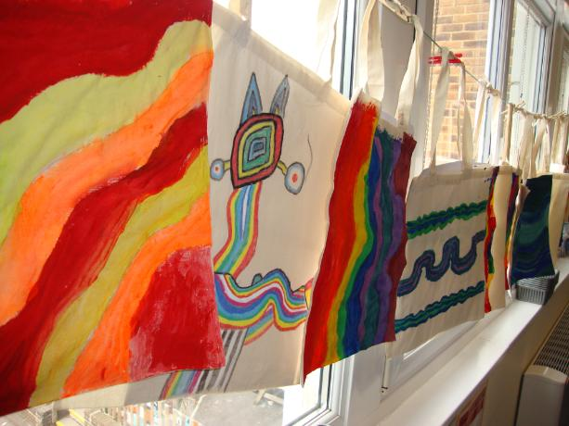
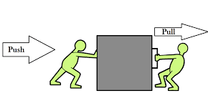
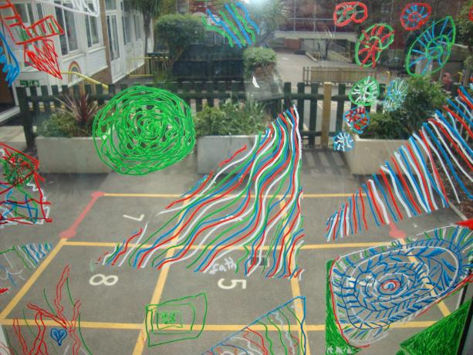
What do we learn about in Spring?
Here is a very light overview, and you will also receive more detailed half-termly overviews.
Spring term 1 Science
Can you feel the force?
We will study forces, including gravity, water resistance, air resistance and friction, and the effect of gears, pulleys, leavers and springs.
Spring term 2 Art
WHOLE SCHOOL ART FOCUS !
We plan this with a local artist and the theme changes every year.
Here are a few past projects…

Slide 9
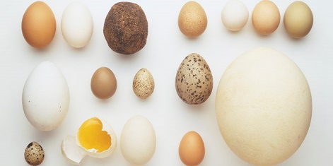
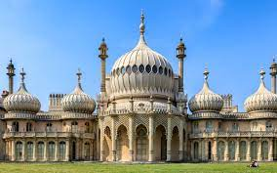
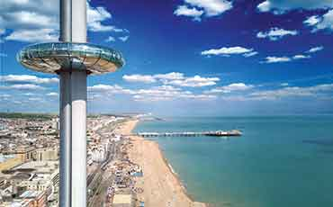
What do we learn about in Summer?
Here is a very light overview, and you will also receive more detailed half-termly overviews.
Summer term 1 Geography
How did Brighton and Hove become the city it is today?
North America – comparative study.
Local physical and human geography including rivers
(6 weeks)
Summer term 2
Science (3 weeks)
Living Things:
Does it all start with an egg?
Have we always looked like this?
History (3 weeks)
The History of the Pavilion
Local History Project (Brighton in WW1)

Slide 10

Homework
We believe that learning is a life-long habit that is not confined to the classroom.
Homework is set on a two-week cycle that follows the same pattern as the school newsletter – there is always a reminder about new homework in the newsletter.
In Key Stage 2, homework is shared on Google Classroom. In each class, the current home-school learning activities will be introduced by the teacher at the start of each two-week cycle.

Slide 11
Homework
At the end of each two-week homework cycle, we monitor the following activities:
wider curriculum activity – some pupils bring this in to share
maths - from Y2 upwards, we monitor maths tasks
English spellings – from Y2 upwards, spellings are informally assessed by the class teacher at the end of each two-week homework cycle
pupils are never sanctioned for not doing their homework

Slide 12
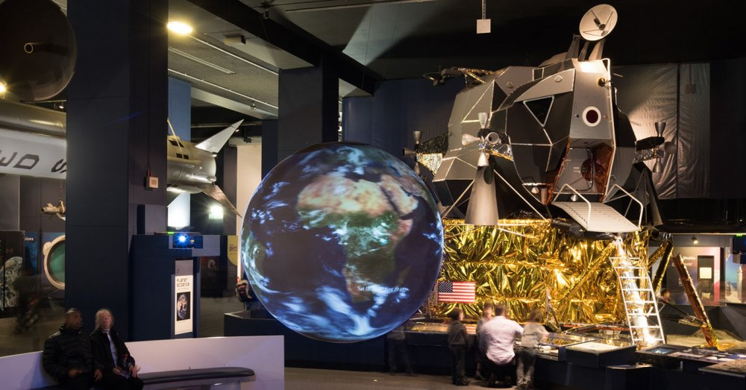
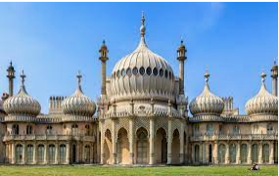
Trips
The Science Museum in London
The Royal Pavilion
The Brighton Museum

Slide 13
Don’t panic. Social dilemmas are part of Year 5!
At age 9 to 10, children undergo rapid cognitive and emotional development, causing their social lives to become significantly more sophisticated and intense.
It is very common for friendships to shift a lot in Y5.
We often see The "best friend" dilemma! The concept of a single "best friend" becomes highly pressurised, often leading to possessiveness, jealousy, and distress if that friend plays with someone else.

Slide 14
Common dilemma’s Year 5 children face
Deliberate exclusion! “Gatekeeping" who can join a game, and the silent treatment become more common tools for establishing social hierarchies.
Fragile self-esteem! Because their identity is increasingly tied to peer validation rather than parental approval, minor social slights can feel devastating to their self-worth.
Conditional friendships! Alliances can shift rapidly; children who are inseparable on Monday might declare they are "no longer friends" by Wednesday, creating an emotional rollercoaster.

Slide 15
Splitting interests! A child who still enjoys imaginative playground games may suddenly find themselves drifting away from a friend who has moved on to chatting about pop culture, styling or social trends.

Slide 16
How you can help at home
Keep talking to us at school – we have school adults who can help!
Validate feelings! Avoid dismissing playground drama - to a 9-year-old, a broken friendship feels like a major life crisis.
Encourage a wide network! Help them maintain friendships outside of school (such as clubs, sports, or family friends) so their entire social identity isn't tied to one classroom.
Roleplay how to say "no" to peer pressure or how to politely ask to join a group game using confident body language.

Slide 17
Does it get easier?
The "drama" itself doesn't completely disappear.
Your child's ability to navigate it will improve as they mature.
The fast-shifting friendship troubles of Year 5 are a necessary, but painful, training ground for building adult relationship skills.
https://parentingsmart.place2be.org.uk/article/my-child-has-friendship-issues

Slide 18
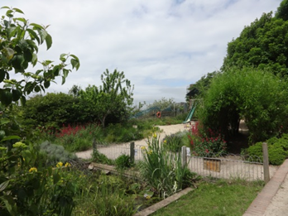
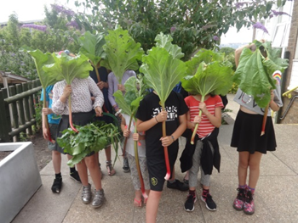
Top 5 Things about Year 5
1. Exciting areas of learning, from Vikings to the mythical Kraken, from
Space to Settlement… and of course Brighton!
2. Amazing trips, including to London.
3. Supportive adults working with you.
4. A reading corner full of exciting books.
5. Added responsibility as you head towards the top of the school.
And remember CARLTON HILL IS AWESOME!

