Slide 1

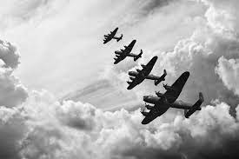
Year 6 curriculum overview
Autumn Term 1 2026
We’ll Meet Again!
Join Year 6 as we start our History topic on World War Two.
We shall be looking at this very important event on a local, national and international scale. What did World War Two mean to those living in Sussex?
Important dates:
Secondary submissions
Deadline 31st October 2025
Trips:
Shoreham Airport – WW2/Art Link
Residential Visit
Take Shelter Visit
Maths
Number and place value, including reading, writing, comparing and ordering numbers to 10,000,000; rounding numbers and negative numbers
The Four Operations: working on efficient written methods for, -, x and ÷
Key questions for History:
Why did Britain go to war in 1939?
Why were children evacuated?
What was the impact of the Blitz?
How did people carry on with normal life during WW2?
What is propaganda?
How did we celebrate the end of the war?
English
Poetry: ’What I Didn’t Do Over The Summer’. We will be performing and writing poems.
Non-fiction:
We will use ‘Youthquake’ by Tom Adams and ‘Anne Frank’s Diary’ to write biographies about young people who shook the world.
Computing:
Learning all about online safety!
What is personal information?
What are the risks of going online?
How should we behave when we are online?
How should we respond to hurtful online behaviour?
RE and PSHE
What is holiness to Jewish people?
New Beginnings & Pupil Voice
Mental Health and Wellbeing
Music
Happy - All the learning in this unit is focused around one song: Happy, a pop song by Pharrell Williams.
PE
Games Activities: Invasion Games – T1 Rugby
Gymnastics - Floor work and routine

