Slide 1
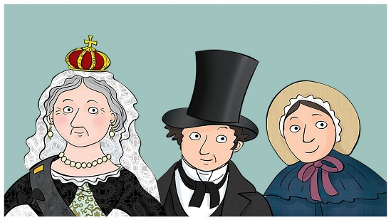
Year 2 topic overview Autumn Term 1 2026
English:
Fiction: ‘Maisie’s Dragon’ journey story
Poetry: ‘The Magic Box’ by Kit Wright
Non fiction: Recount on our trip to Preston Manor
Fiction: Whatever Wanda Wanted
Computing:
We are safe online
How to keep safe when online
What to do if not feeling safe online
What a password is and why data protection is important.
Maths:
Place value, numbers to 20, number bonds to 10, numbers to 100 in steps of 10, partitioning numbers to 100, write numbers in words
History Topic
Victorians
RE and PSHE:
New beginnings
Emotions and the ‘Just Right’ tower
Citizenship – how can we be a good citizen for our community?
PE:
Gymnastics – Tuesday
Rugby fundamentals - Thursday
PSHE
What do we know about each other?
Why do we need rules? How can we work well together?
Who am I?
How am I the same and different as my friends?
How does sleep affect my mood?
How can I regulate my emotions?
What makes me feel in the green zone?
History Key questions for topic:
Who were the ‘Victorians?’
What was Brighton like in Victorian times?
What was life like in Victorian Brighton?
What was it like to be a child living in Victorian Brighton?
How is Victorian life the same and different to today?
Music - Exploring Simple Patterns
How does music help us to make friends?
Singing – tempo and scales
Trip: Preston Manor – more details to come.

