Slide 1


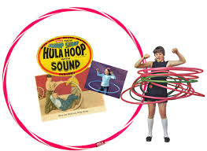

Year One Topic Overview Autumn 1 2026
English:
Reading
Phonics – Little Wandle
Poetry – The Happy Poem by James Carter
Fiction – The Three Little Pigs
Important dates
Phonics and reading meeting:
Monday 21st September 8.50am in the hall
10 minutes of fame:
Friday 13th November 9am in the hall
Maths:
Numbers 1-10
Place Value
Counting
Reading and writing numbers in numerals and words
Grouping and Sorting
Are our grandparent’s toys more fun than ours?
What games did your grandparents play with?
Do you play any games your grandparents played with?
Key questions for topic:
What was on Mum/Dad/Grandma and Grandad’s toy wish list?
How do we know about toys in the past?
What can we use to find out about toys in the past?
Would Grandad and Grandma have bought their toys on the internet?
How many popular toys need electricity or batteries now? How many popular toys needed electricity or batteries before?
How do you know something is old?
How can we describe old and new toys?
What is the same and what is different about old and new toys?
How can we show what we have learnt about toys in the past?
Computing:
We are safe online
PSHE:
New Beginnings
RE:
Updates coming
PE:
Ball Games and Gymnastics
Music:
Introducing a beat

Slide 2
